Slide 1
D/W Angular React, Vue

Slide 2
Agenda
What is a framework ?
What is a library?
Frameworks backgrounds.
Philosophies.
Comparing syntax.
Learning scale.

Slide 3
Agenda
Framework size.
Popularity.
“what the market says”
(jobs, download statistics etc)

Slide 4
Which one is best?
Framework is a piece of code that performs a certain job.
Code reusability
Ensures quick development of an application
Easier to debug a program.

Slide 5
What is a library?
Make use of legally in building their programs.
No best framework or library here.
Way of approaching things and if you like how you write code with it.

Slide 6
Framework background
Angular is a framework developed by Google in 2010.
React is a library built by Facebook in 2013.
Vue is a “standalone” project that is not built inside of any company.

Slide 7
Comparing Philosophies
Angular is “platform” rather than a framework.
React is all about components.
Vue is a framework which kind of sits between React and Angular.

Slide 8
Comparing syntax
Angular use TypeScript.
React typically uses JavaScript.
Vue uses regular JavaScript.

Slide 9
Learning Scale
Vue is probably the framework that is easiest to learn.
JavaScript & HTML.
Both Angular and React.
Need to learn TypeScript.
React get into JSX syntax.

Slide 10
Framework size
Angular is the heaviest of all with 143k.
React with 43k.
Vue.js is the most lightweight – its size is only 23k.

Slide 11
Comparing adoption and popularity
Google Trends.
npm Package Downloads.
Open Job Offerings.

Slide 12
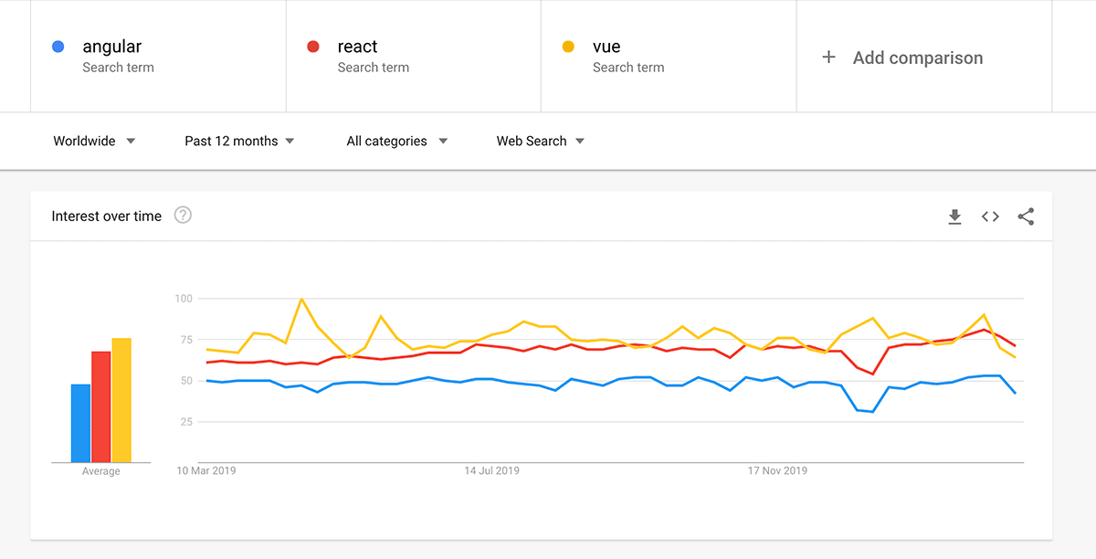
Google trends

Slide 13
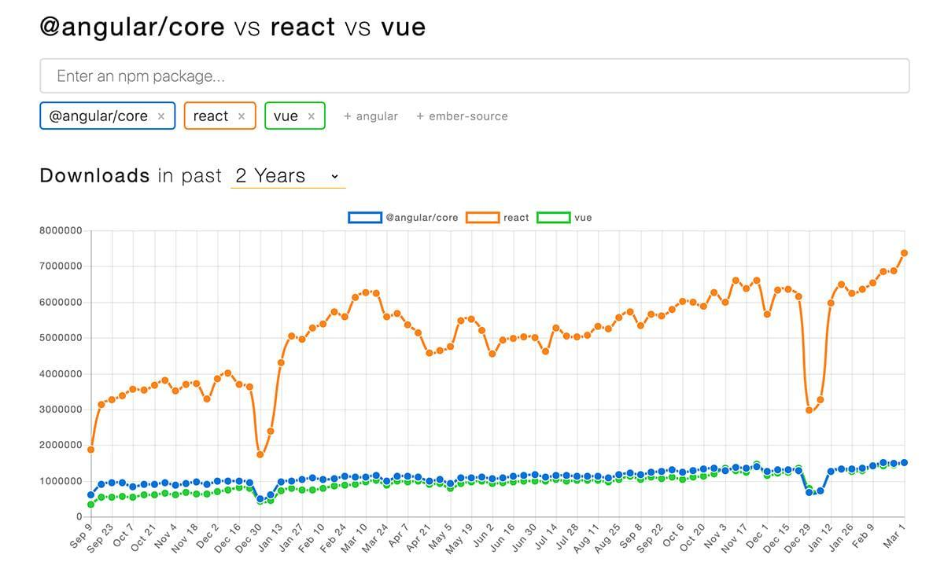
Npm package downloads

Slide 14
Jobs
“Angular” jobs on March 5th 2020 gave me 16,237 job listings on indeed.com.
“React” jobs on March 5th 2020 gave me 60,595 job listings.
“Vue” jobs on March 5th 2020 gave me 3,914 job listings.

Slide 15
Conclusion
Vue definitely is very popular amongst developers.
Angular is popular both amongst developers as well as employers.
The winner clearly is React.

